Slide 1

The Cortana Intelligence Suite
Foundations – Modeling for Machine Learning and Data Mining
Microsoft Machine Learning and Data Science Team
CortanaIntelligence.com
Notes:
Main page: http://cortanaanalytics.com
To begin this module, you should have:
Basic Math and Stats skills
Business and Domain Awareness
General Computing Background
NOTE: These workbooks contain many resources to lead you through the course, and provide a rich set of references that you can use to learn much more about these topics. If the links do not resolve properly, type the link address in manually in your web browser. If the links have changed or been removed, simply enter the title of the link in a web search engine to find the new location or a corollary reference.

Slide 2
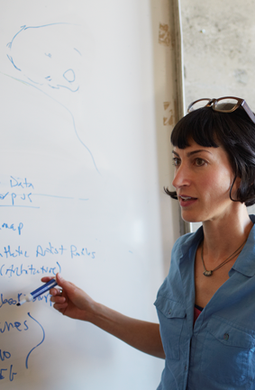
Section 4 Learning Objectives
Understand Azure ML and how experiments are created
Understand how MRS can be used to perform Machine Learning experiments
Use ADF to schedule Azure ML Activities
Notes:
At the end of this Module, you will:
Understand Azure ML and how experiments are created
Understand how MRS can be used to perform Machine Learning experiments
Use ADF to schedule Azure ML Activities

Slide 3
The Data Science Process and Platform

Slide 4
The Team Data Science Process
Business Understanding
Define Objectives
Identify Data Sources
Data Acquisition and Understanding
Ingest Data
Explore Data
Modeling
Feature Selection
Create and Train Model
Deployment
Customer Acceptance
Operationalize
Testing and Validation
Update Data
Handoff
Re-train and re-score
Notes:
This process largely follows the CRISP-DM model: http://www.sv-europe.com/crisp-dm-methodology/
It also references the Cortana Intelligence process: https://azure.microsoft.com/en-us/documentation/articles/data-science-process-overview/
A complete process diagram is here: https://azure.microsoft.com/en-us/documentation/learning-paths/cortana-analytics-process/
Some walkthrough’s of the various services: https://azure.microsoft.com/en-us/documentation/articles/data-science-process-walkthroughs/
An integrated process and toolset allows for a more close-to-intent deployment
Iterations are required to close in on the solution – but are harder tio management and monitor
Data Science Blog: https://buckwoody.wordpress.com/

Slide 5
The Cortana Intelligence Platform
Cortana, Cognitive Services, Bot Framework
Power BI
HDInsight
Stream Analytics
Azure Machine Learning (MRS)
SQL Data Warehouse (SQL DB, Document DB)
Data Lake
Event Hubs
Data Factory
Data Catalog
Microsoft Azure
Notes:
Platform and Storage: Microsoft Azure – http://microsoftazure.com Storage: https://azure.microsoft.com/en-us/documentation/services/storage/ (Host It)
Azure Data Catalog: http://azure.microsoft.com/en-us/services/data-catalog (Doc It)
Azure Data Factory: http://azure.microsoft.com/en-us/services/data-factory/ (Move It)
Azure Event Hubs: http://azure.microsoft.com/en-us/services/event-hubs/ (Bring It)
Azure Data Lake: http://azure.microsoft.com/en-us/campaigns/data-lake/ (Store It)
Azure DocumentDB: https://azure.microsoft.com/en-us/services/documentdb/ , Azure SQL Data Warehouse: http://azure.microsoft.com/en-us/services/sql-data-warehouse/ (Relate It)
Azure Machine Learning: http://azure.microsoft.com/en-us/services/machine-learning/ (Learn It)
Azure HDInsight: http://azure.microsoft.com/en-us/services/hdinsight/ (Scale It)
Azure Stream Analytics: http://azure.microsoft.com/en-us/services/stream-analytics/ (Stream It)
Power BI: https://powerbi.microsoft.com/ (See It)
Cortana: http://blogs.windows.com/buildingapps/2014/09/23/cortana-integration-and-speech-recognition-new-code-samples/ and https://blogs.windows.com/buildingapps/2015/08/25/using-cortana-to-interact-with-your-customers-10-by-10/ and https://developer.microsoft.com/en-us/Cortana (Say It)
Cognitive Services: https://www.microsoft.com/cognitive-services
Bot Framework: https://dev.botframework.com/
All of the components within the suite: https://www.microsoft.com/en-us/server-cloud/cortana-intelligence-suite/what-is-cortana-intelligence.aspx
What can I do with it? https://gallery.cortanaintelligence.com/
Getting Started Quickly: https://caqs.azure.net/#gallery

Slide 6
Module 1: Azure ML
Notes:
Example paths for using Azure ML: https://azure.microsoft.com/en-us/documentation/articles/machine-learning-data-science-plan-sample-scenarios/

Slide 7
Machine Learning in 5 Minutes
The Formal one:
“A computer program is said to learn from experience E with respect to some class of tasks T and performance measure P if its performance at tasks in T, as measured by P, improves with experience E.”
A Practical Example:
Look at data. Do the thing. Better? No? Look at the data. Do something different. Better? Yes? Do that again. (Repeat)
Notes:
Choosing an Algorithm for Machine Learning: https://azure.microsoft.com/en-us/documentation/articles/machine-learning-algorithm-choice/

Slide 8
Machine Learning Capabilities
Which category
(Classification)
How much/many
(Regression)
Which group
(Clustering,
Recommender)
Is it odd
(Anomaly)
Which action
(Reinforcement Learning)
Notes:
Regression: Predict a real value for each item (stock/currency value, temperature). – How much/how many?
Classification: Assign a category to each item (Chinese | French | Indian | Italian | Japanese restaurant). – Which Category?
Clustering/Recommendation: Partition items into homogeneous groups (clustering twitter posts by topic). – Which Groups?
Anomaly: Identify when something unexpected happens. – Is this weird?
Reinforcement Learning: Make an appropriate action for some new data. – Which action?

Slide 9
Machine Learning Algorithms
Split into two main categories:
Supervised learning
Predicting the future
Learn from known past examples to predict future
Labels provided
Unsupervised learning
Making sense of data
Understanding the past
Learning the structure of data
Labels no provided
Notes:
Algorithm Documentation: https://msdn.microsoft.com/library/dn905974.aspx
Exploring: https://azuremlsimpleds.azurewebsites.net/simpleds/

Slide 10
The Azure ML Environment
Development Environment
Creating Experiments
Sharing a Workspace
Deployment Environment
Publishing the Model
Using the API
Consuming in various tools
Notes:
Guided tutorials: https://azure.microsoft.com/en-us/documentation/services/machine-learning/
Microsoft Azure Virtual Academy course: https://mva.microsoft.com/en-US/training-courses/microsoft-azure-machine-learning-jump-start-8425?l=ehQZFoKz_7904984382

Slide 11
Creating an Experiment
Create
Workspace
Build and Model
Deploy Model
Consume Model
Get/Prepare Data
Evaluate Model Results
Build/Edit Experiment
Create/Update Model
Notes:
Beginning Series: https://azure.microsoft.com/en-us/documentation/articles/machine-learning-data-science-for-beginners-the-5-questions-data-science-answers/

Slide 12
Basic Azure ML Elements
Import Data
Preprocess
Algorithm
Split Data
Train Model
Score Model
Notes:
Designing an experiment in the Studio: https://azure.microsoft.com/en-us/documentation/articles/machine-learning-what-is-ml-studio/

Slide 13
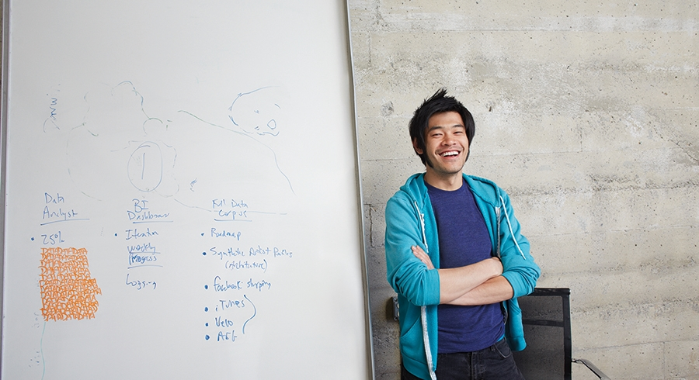


Lab:
Optional: Create and Run an Experiment in Azure ML
Notes:
Open the AML Student Workbook from your \Resources folder
Follow the instructions you find there

Slide 14
Module 2: Microsoft R Server for Machine Learning
Notes:
Primary documentation: https://www.microsoft.com/en-us/server-cloud/products/r-server/

Slide 15
Distributions of R
Microsoft R Server
Enterprise-class high-performance analytics distribution
Parallel external memory algorithms with the RevoScaleR library
No threads limits
Out-of memory computation with the XDF file format
Deployment capabilities through the mrsdeploy package
Commercial support
Available in Linux (Red Hat, CentOS), Windows, SQL Server, Spark, Hadoop and Teradata
Battle-tested Microsoft Research libraries for state-of-the-art machine learning with MicrosoftML
CRAN-R
a.k.a., GNU-R
Single-threaded
In-memory
10K+ packages
Interfaces to C++, C, and Fortran for speed
Cross-platform
MRO
GNU-R + Intel MKL = multi-threaded linear algebra
100% CRAN-R compatible
Reproducible R toolkit with the checkpoint package
Open-source
R Client
High-performance analytics with the RevoScaleR package
Two-threads
Deployment capabilities through the mrsdeploy package
MicrosoftML
Free, windows
In-memory distributions
Out-of-memory, multicore, multi-node, Parallel Algorithms

Slide 16

Parallelized, Distributed Execution Algorithms
Data Step
Data import – Delimited, Fixed, SAS, SPSS, OBDC
Variable creation & transformation
Recode variables
Factor variables
Missing value handling
Sort, Merge, Split
Aggregate by category (means, sums)
Statistical Tests
Chi Square Test
Kendall Rank Correlation
Fisher’s Exact Test
Student’s t-Test
Variable Selection
Stepwise Regression
Simulation
Simulation (e.g. Monte Carlo)
Parallel Random Number Generation
Sampling
Subsample (observations & variables)
Random Sampling
Cluster Analysis
K-Means
Descriptive Statistics
Min / Max, Mean, Median (approx.)
Quantiles (approx.)
Standard Deviation
Variance
Correlation
Covariance
Sum of Squares (cross product matrix for set variables)
Pairwise Cross tabs
Risk Ratio & Odds Ratio
Cross-Tabulation of Data (standard tables & long form)
Marginal Summaries of Cross Tabulations
Predictive Models
Sum of Squares (cross product matrix for set variables)
Quantiles (approx.)
Generalized Linear Models (GLM) exponential family distributions: binomial, Gaussian, inverse Gaussian, Poisson, Tweedie. Standard link functions: cauchy, identity, log, logit, probit. User defined distributions & link functions.
Covariance & Correlation Matrices
Logistic Regression
Classification & Regression Trees
Predictions/scoring for models
Residuals for all models
Classification
Decision Trees
Decision Forests
Gradient Boosted Decision Trees
Naïve Bayes
Combination
rxDataStep
rxExec
PEMA-R API Custom Algorithms

Slide 17
Lab:
Optional: Machine Learning with MRS
Notes:
Open the MRS Student Workbook document from your \Resources file
Locate the section marked “Predictive Modeling with MRS” and follow the instructions there

Slide 18
Module 3: Azure Data Factory and Azure ML
Notes:
Create Predictive Pipelines using Azure ML Activities in ADF: https://azure.microsoft.com/en-us/documentation/articles/data-factory-azure-ml-batch-execution-activity/

Slide 19
Deploying the Model
Create
Workspace
Build and Model
Deploy Model
Consume Model
Get/Prepare Data
Evaluate Model Results
Build/Edit Experiment
Create/Update Model
Notes:
Deploying the Azure ML Model: https://azure.microsoft.com/en-us/documentation/articles/machine-learning-walkthrough-5-publish-web-service/

Slide 20
Understand Azure ML and how experiments are created
Understand how MRS can be used to perform Machine Learning experiments
Use ADF to schedule Azure ML Activities
Notes:
Questions?

